Slide 1
SYSTEM MODELLING OF A CAR FAULT DIAGNOSIS APP
By Group 2

Slide 2
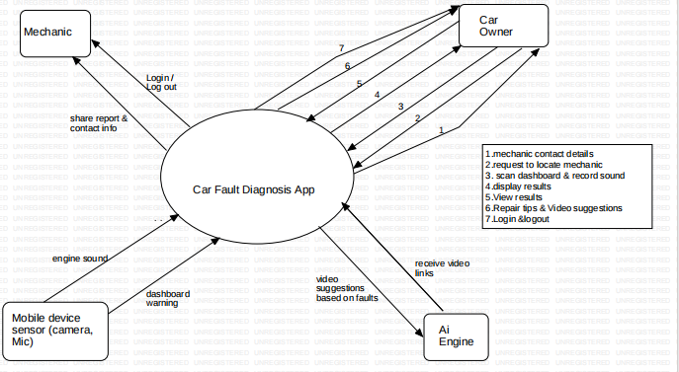
CONTEXT DIAGRAM

Slide 3
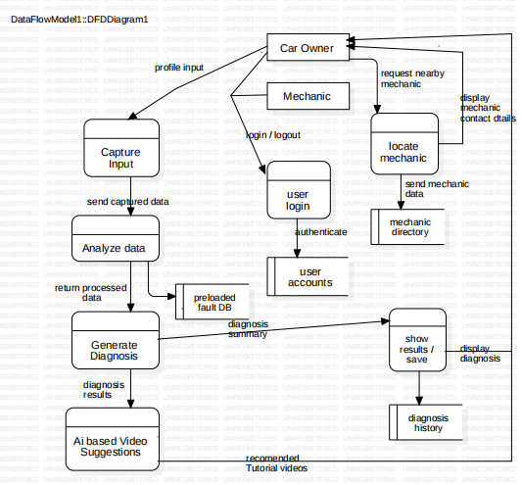
DATA FLOW DIAGRAM

Slide 4
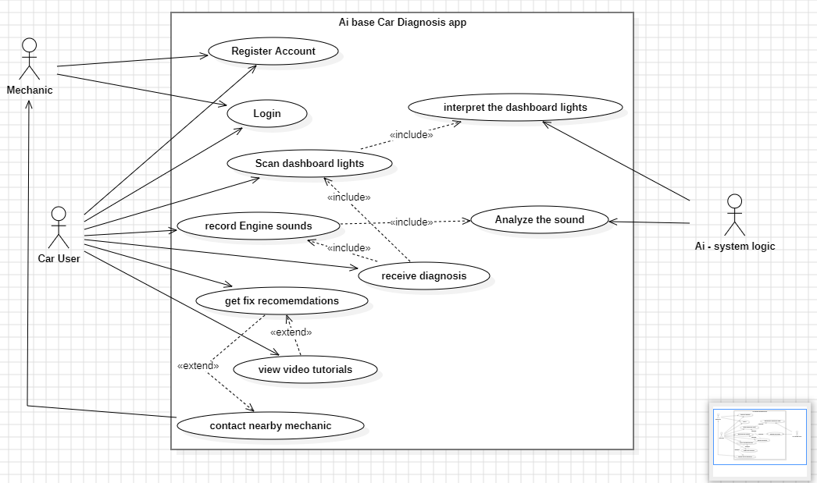
USE CASE DIAGRAM

Slide 5
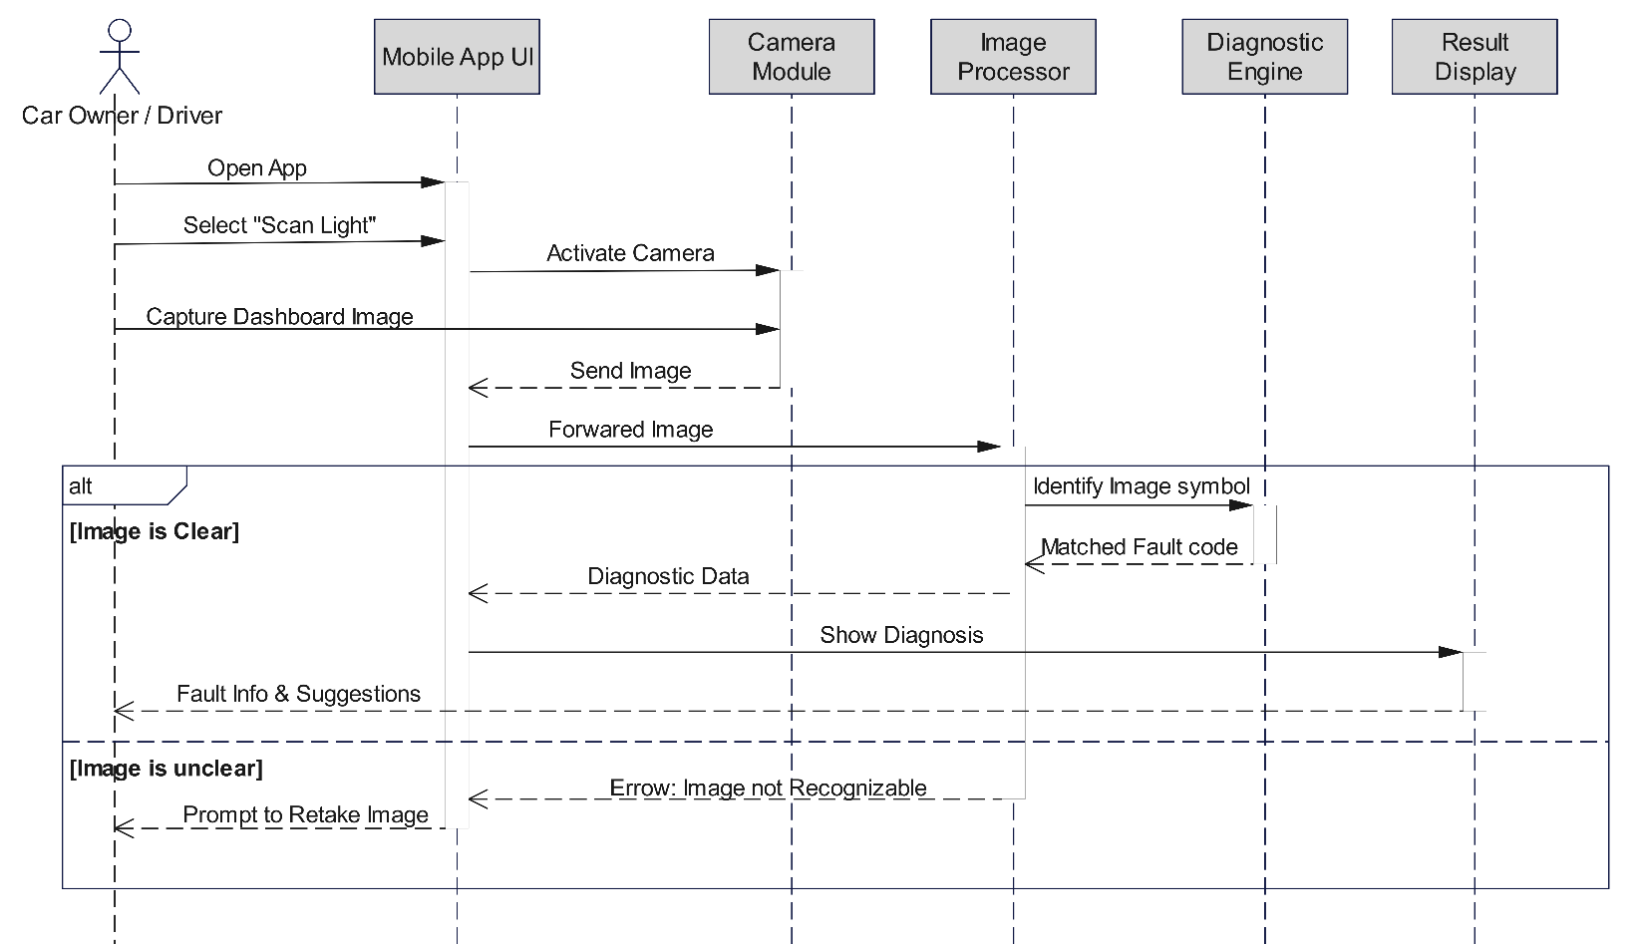
SEQUENCE DIAGRAMS
Scan Dashboard Light and Receive Diagnosis

Slide 6

Record Engine Sound and Receive Diagnosis

Slide 7
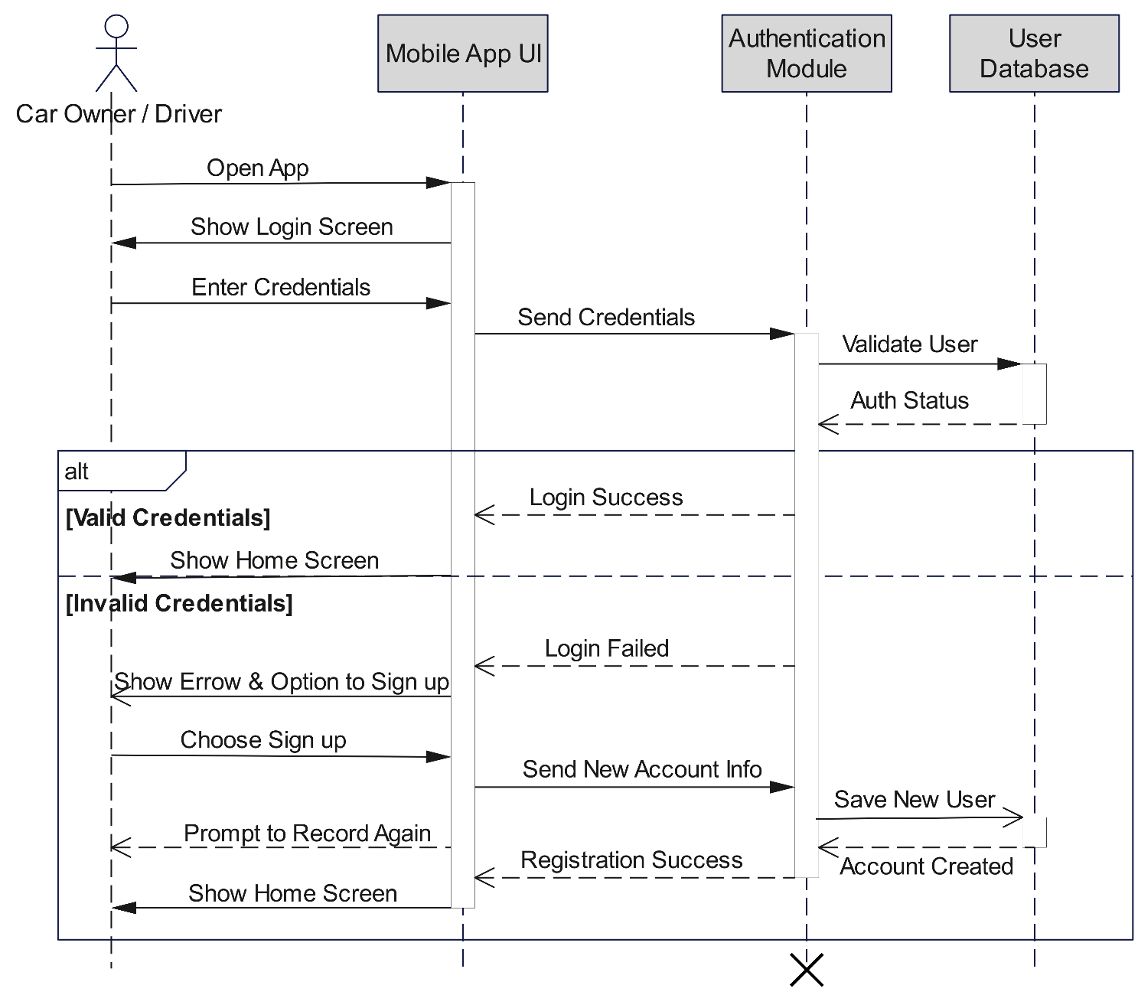
Login, Logout and Sign Up

Slide 8
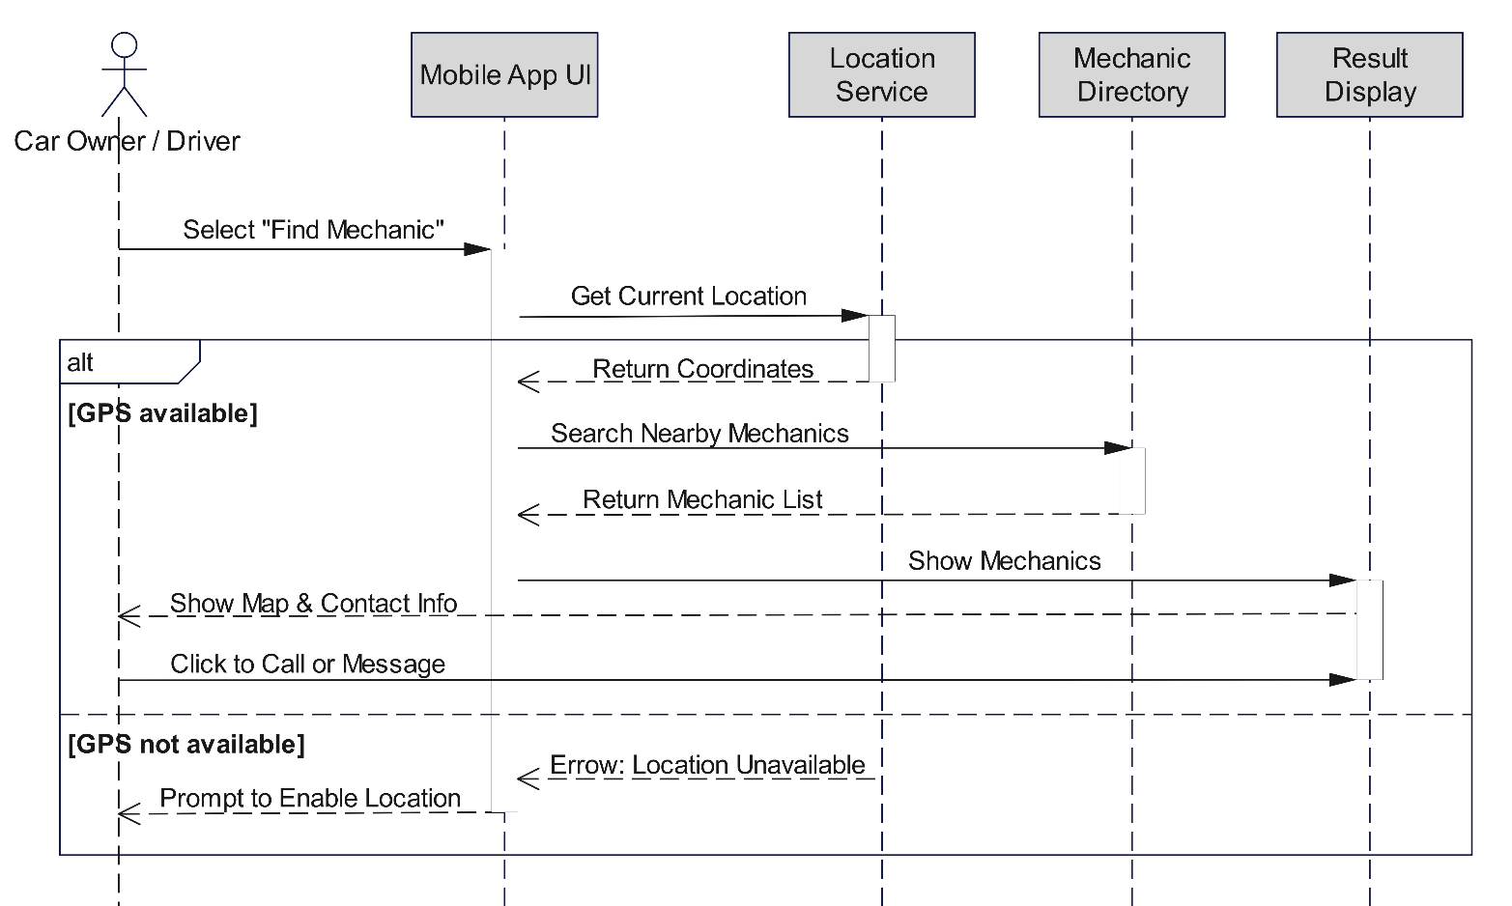
Locate and Contact Mechanic

Slide 9
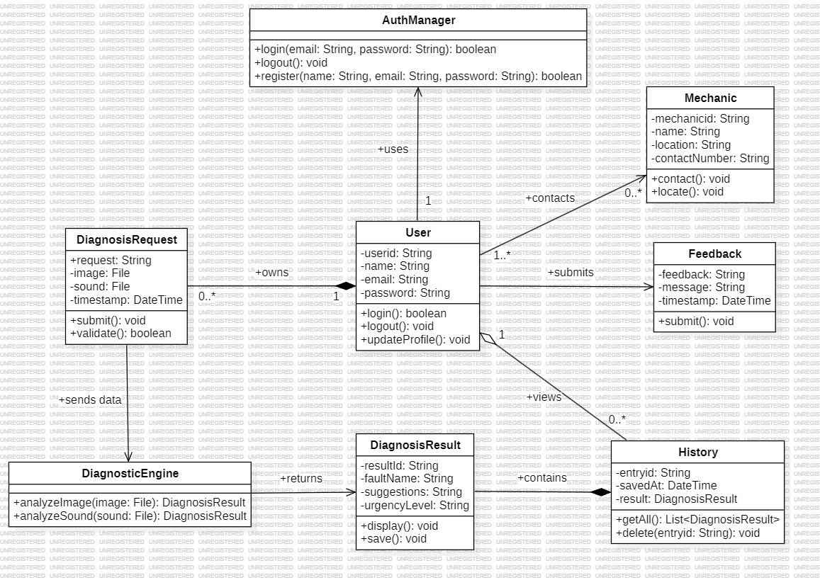
CLASS DIAGRAM

Slide 10
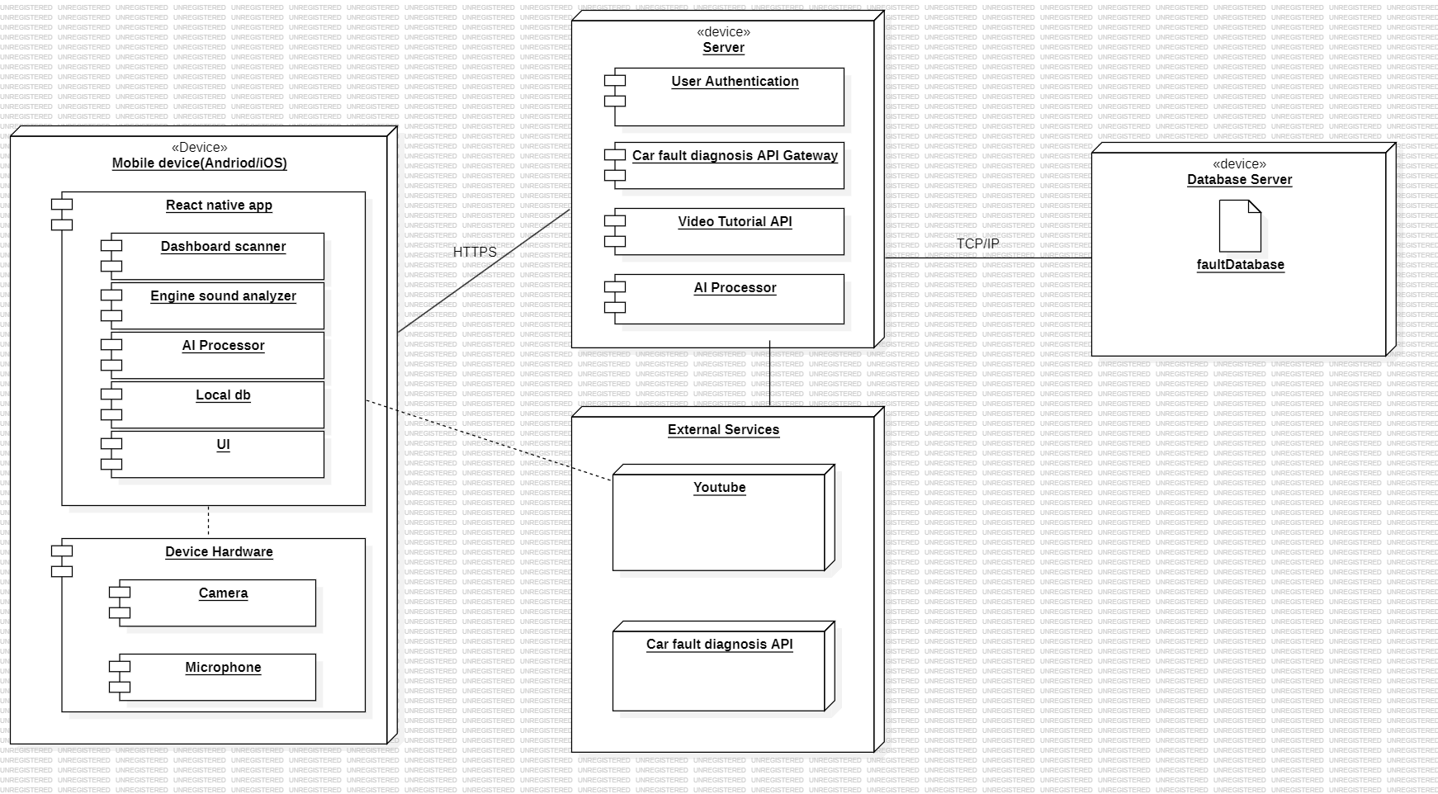
DEPLOYMENT DIAGRAM

Slide 11
THANK YOU!!

